Slide 1
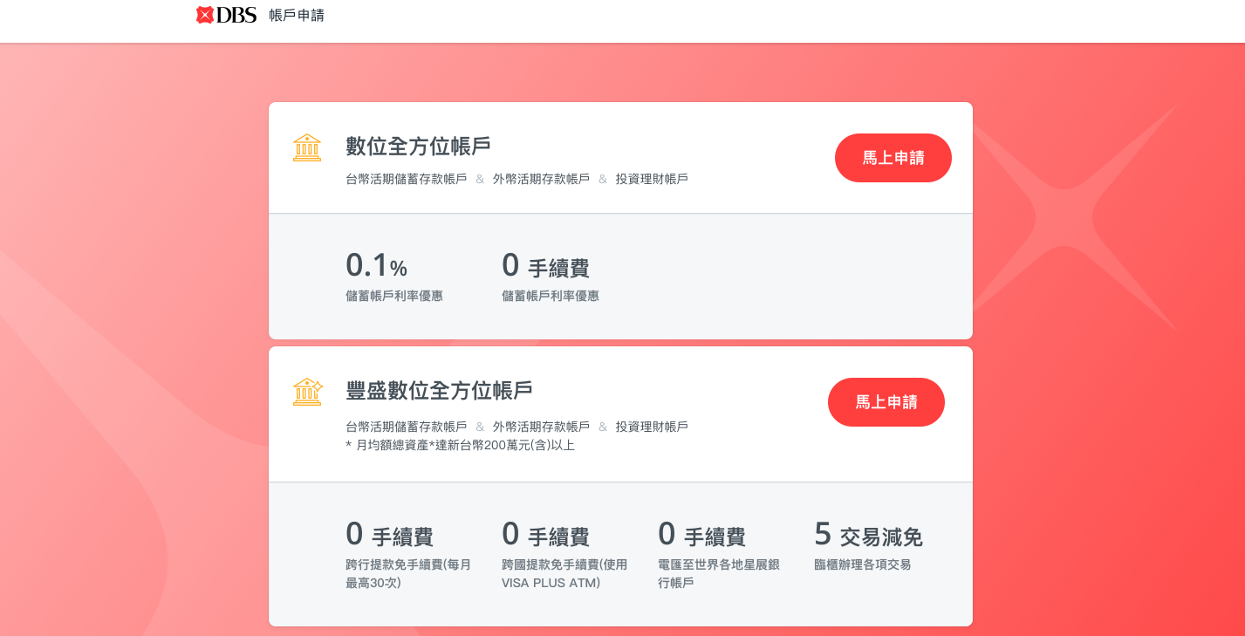
DBS TW
CASA Onboarding
By Chen Jia
Apr, 2018

Slide 2
Agenda
Project Objective
Better customer convenience and customer experience
Customer Journey Screen flow
Web
Mobile
Other Key Functionalities
Upload document & OCR
Field Pre-population & Error message
Save & Resume and Timeout
Email/SMS notification
IWF screen & Reports
IWF Case Status
Offline process
CRM
FAQ
Handling potential queries

Slide 3
Project Objective
Objectives:
To introduce Online form for Digital account application
Create TWD & FCY CASA, investment accounts and FD Master account online for both NTB and ETB
Hassle free application process – Customer not required to mail in paper application
Optimize Operations process
Target customers:
Covered customer | Existing CIF | Existing account | Existing Credit card | Authentication method
NTB | x | x | x | Other bank details
Returning | suspended/active | x | x | Other bank details
Existing customer with loan | active | loan account | x | Other bank details
Existing customer with credit card | x | x | have more than 6 mths active/dormant card | Other bank details/ Credit card details
Existing customer with credit card and loan | active | loan account | have more than 6 mths active/dormant card | Other bank details/ Credit card details

Slide 4
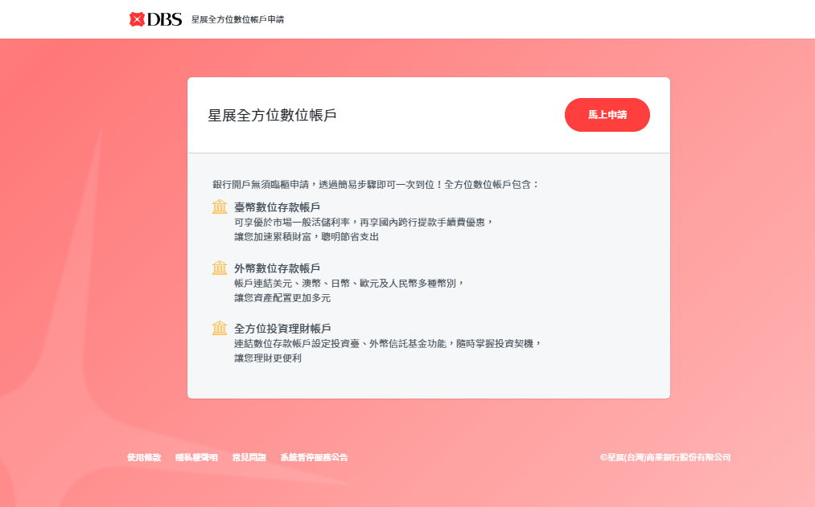
Customer Journey Screen Flow (Web)
Customer can choose to open TWD CASA, FCCY CASA, TWD and FCCY Investment Acc and FD Acc
*DAO Application Step 0: MASS Customer*

Slide 5
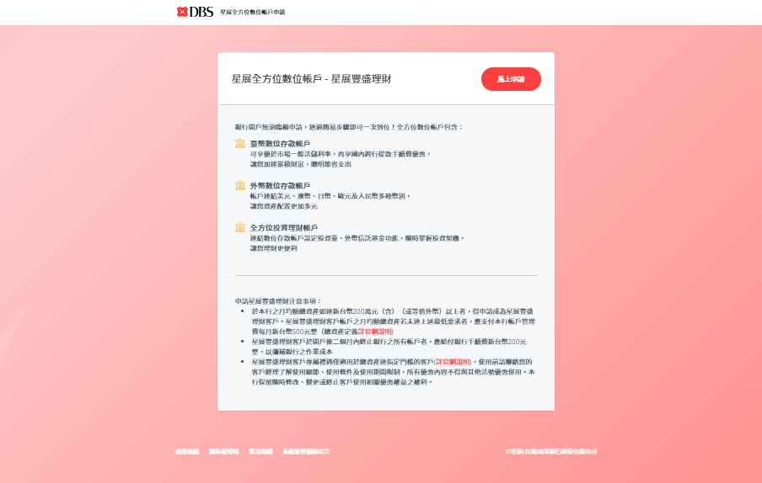

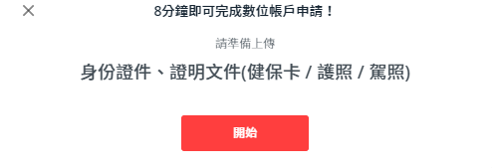
Customer Journey Screen Flow (Web)
Customer can choose to open TWD CASA, FCCY CASA, TWD and FCCY Investment Acc and FD Acc
Important Notice popup is displayed
*DAO Application Step 0: TR Customer*

Slide 6
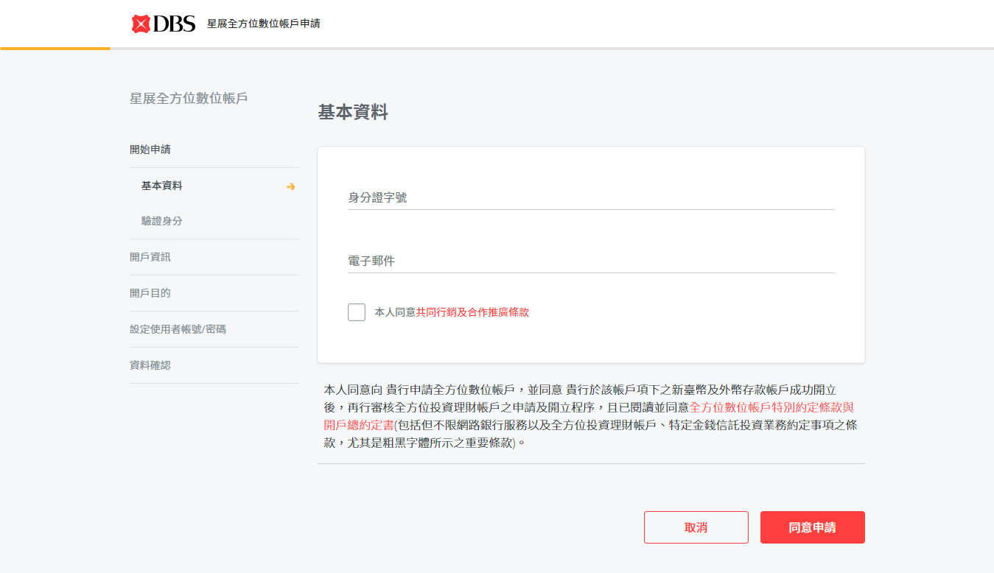
Customer Journey Screen Flow (Web)
基本資料
Fields
NID
Input
Email Address
Input
Joint Market Info (check box)
Tick (Optional)
驗證身分
上傳證件
開戶資訊
職業資訊
開戶目的
資金來源
賬號密碼
資料確認
完成申請
網銀登陸
*Basic Information Page*

Slide 7
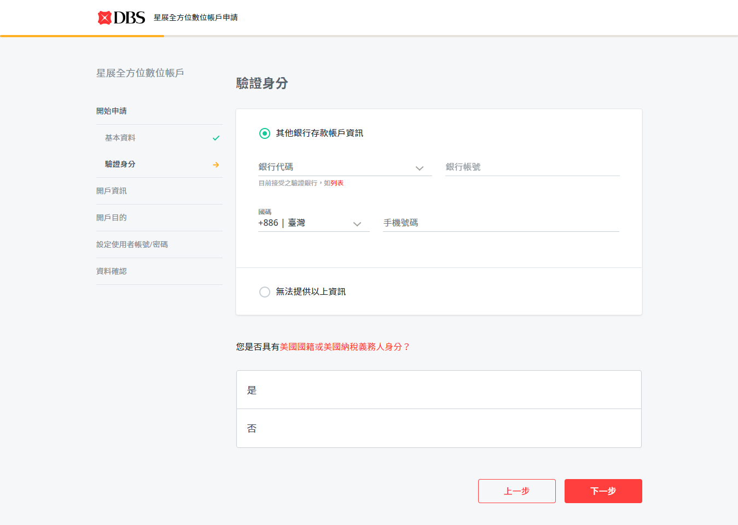
Customer Journey Screen Flow (Web)
基本資料
Fields
Other Bank Authentication
Bank Code (Dropdown)
Select
Bank Account
Input
Country Code (Dropdown)
Select
Handphone Number
Input
Don’t have above document
FATCA Section
FATCA (radio button)
Select
驗證身分
上傳證件
開戶資訊
職業資訊
開戶目的
資金來源
賬號密碼
資料確認
完成申請
網銀登陸
*Other Bank Authentication Page*

Slide 8
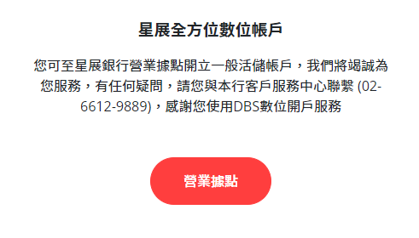

Customer Journey Screen Flow (Web)
基本資料
驗證身分
上傳證件
開戶資訊
職業資訊
開戶目的
資金來源
Full Screen msg on clicking on Next button
賬號密碼
資料確認
Note: The msg is requesting customers to go to branch to open account.
完成申請
網銀登陸
*Other Bank Authentication Page*

Slide 9
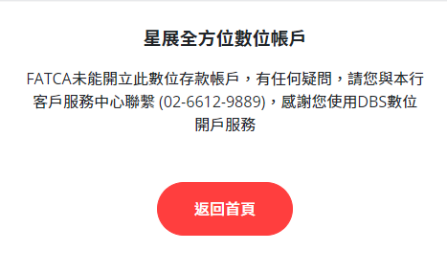
Customer Journey Screen Flow (Web)
基本資料
驗證身分
上傳證件
開戶資訊
職業資訊
開戶目的
資金來源
Full screen error msg to indicate FATCA is not able to open this account from DAO
賬號密碼
資料確認
完成申請
網銀登陸
*Other Bank Authentication Page*

Slide 10
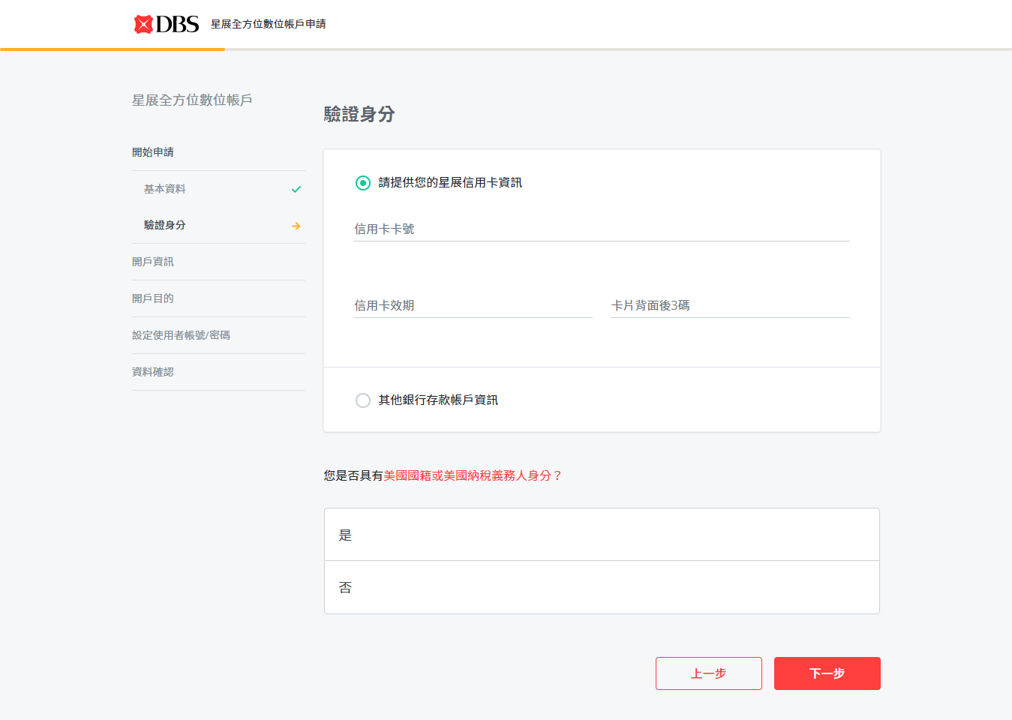
Customer Journey Screen Flow (Web)
基本資料
Fields
Credit Card Authentication
Credit Card Number
Input
CC Expiry Date
Input
CVV
Input
Other Bank Authentication
FATCA Section
FATCA (radio button)
Select
驗證身分
上傳證件
開戶資訊
職業資訊
開戶目的
資金來源
賬號密碼
資料確認
完成申請
網銀登陸
*Credit Card Authentication Page*

Slide 11
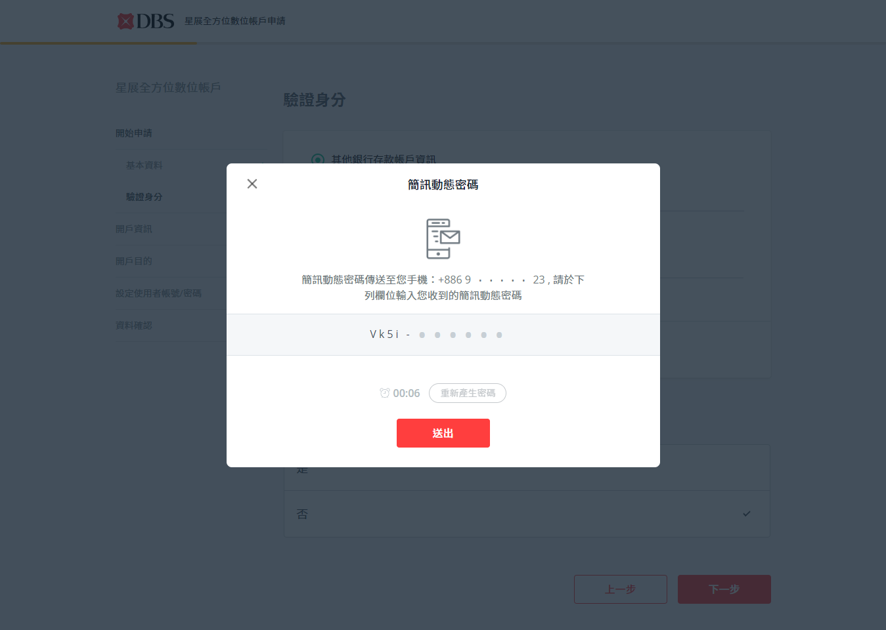
Customer Journey Screen Flow (Web)
基本資料
驗證身分
上傳證件
Fields
OTP Number
Input
開戶資訊
職業資訊
開戶目的
資金來源
賬號密碼
資料確認
完成申請
網銀登陸
*OTP Page*
Notes:
Customer to input OTP no from verification SMS

Slide 12
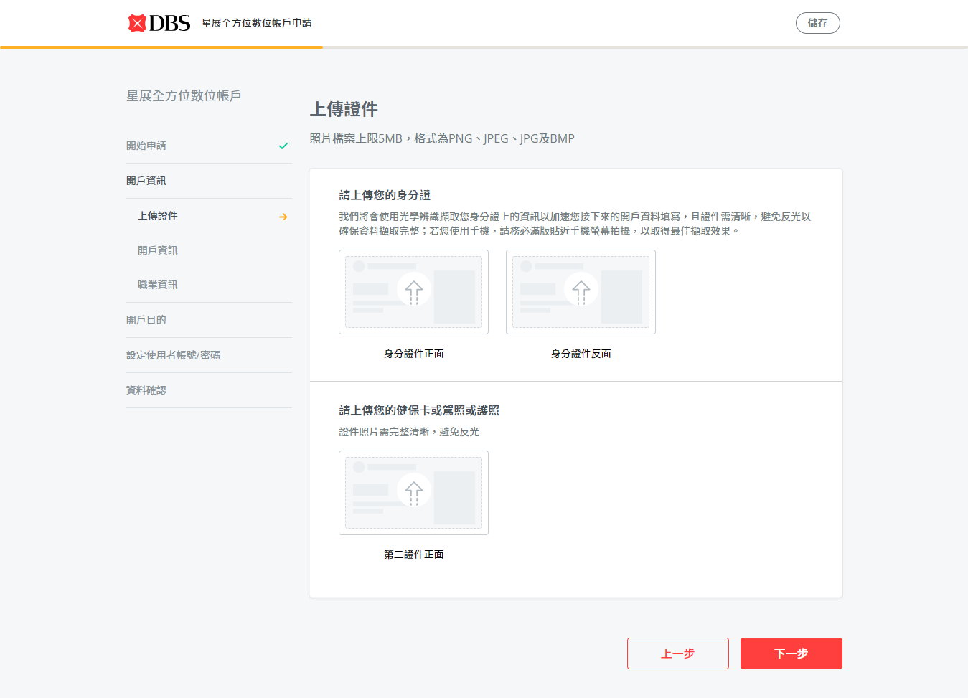
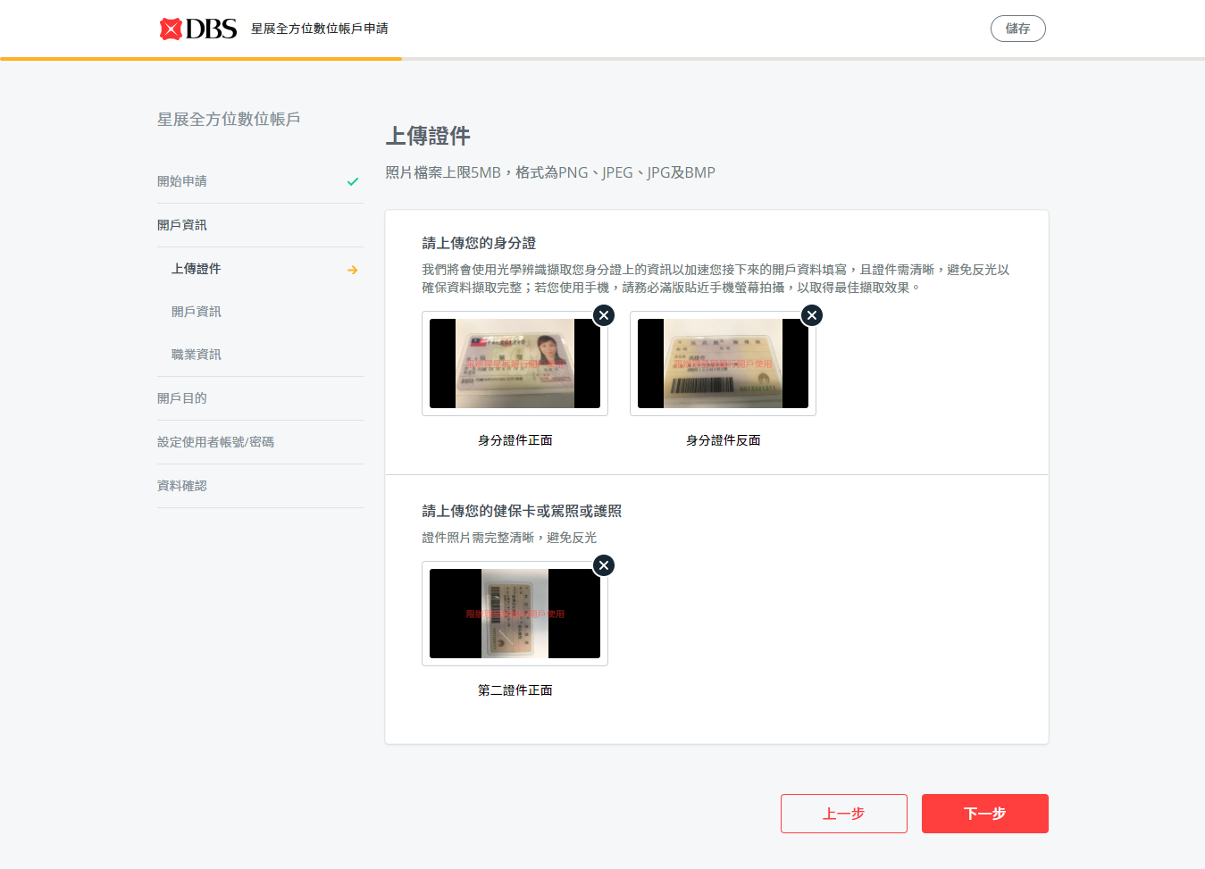
Customer Journey Screen Flow (Web)
基本資料
Fields
身分證號正面
Drag or Browser from Gallery
身分證號背面
Drag or Browser from Gallery
第二證件正面
Drag or Browser from Gallery
驗證身分
上傳證件
開戶資訊
職業資訊
開戶目的
資金來源
賬號密碼
資料確認
完成申請
Note: Photos display with watermark when upload successfully
網銀登陸
*Photo Upload Page*

Slide 13
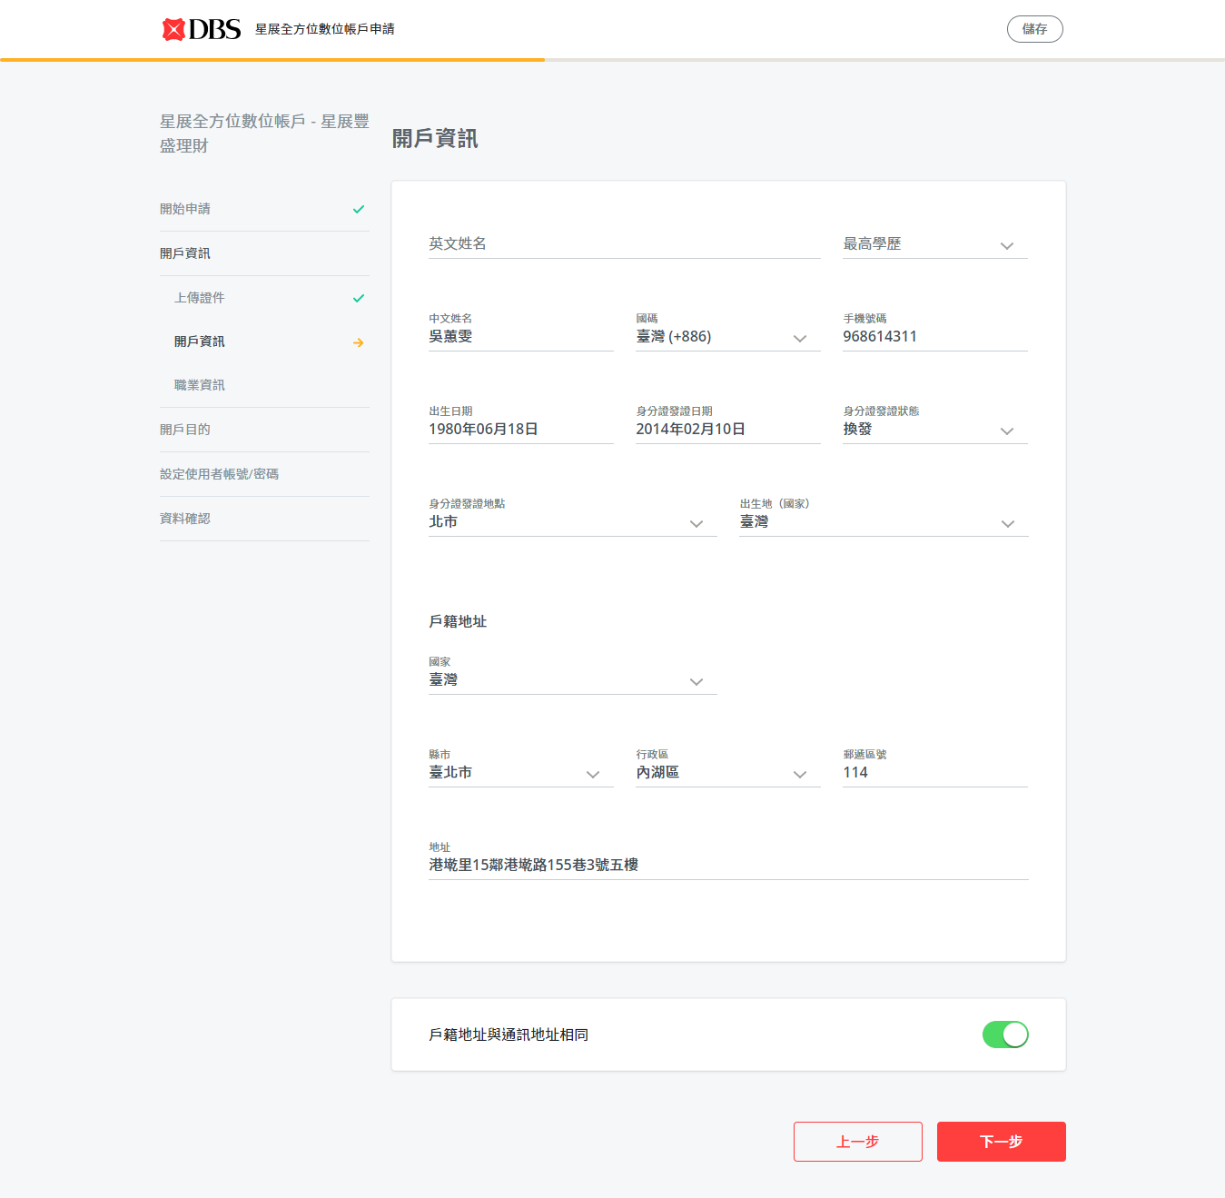
Customer Journey Screen Flow (Web)
Fields
English Name
Finacle/Input
Education
Finacle/V+/Input
Chinese Name
Finacle/V+/OCR/Input
Handphone No.
Finacle/V+/Input
Date of Birth
Finacle/V+/OCR/Input
Issue Date
OCR/Input
Issue Place
OCR/Input
Issue Status
OCR/Input
基本資料
驗證身分
上傳證件
開戶資訊
職業資訊
開戶目的
資金來源
賬號密碼
Birth Place(Country)
OCR/Input
Resi Address- Country
Finacle/V+/OCR/Input
Resi Address- Address
County/City/District/Postal Code/Address
Finacle/V+/OCR/Input
資料確認
完成申請
網銀登陸
Note: 4 ways to get data: prepopulated from Finacle, V+, OCR and manually input
*Personal Info Page*

Slide 14
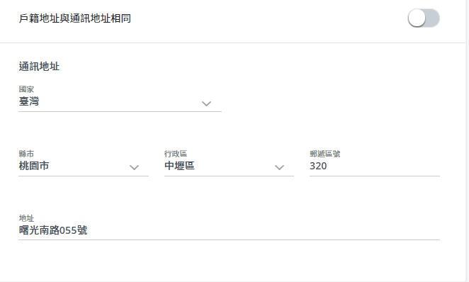
Customer Journey Screen Flow (Web)
基本資料
驗證身分
上傳證件
開戶資訊
職業資訊
開戶目的
Note: Select toggle button off can input mailing address that is different from Residential address
資金來源
賬號密碼
Fields
Resi Address- Country
Finacle/V+/OCR/Input
Resi Address- Address
County/City/District/Postal Code/Address
Finacle/V+/OCR/Input
資料確認
完成申請
網銀登陸
*Personal Info Page*

Slide 15
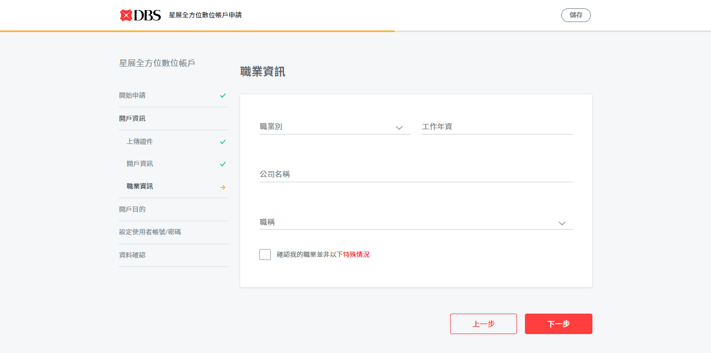
Customer Journey Screen Flow (Web)
基本資料
Fields
職業
Finacle/ Input
年資 (年/月)
Finacle/V+/ Input
公司名稱
Finacle/V+/ Input
職稱
Finacle/V+/ Input
High Risk occupation
check box
驗證身分
上傳證件
開戶資訊
職業資訊
開戶目的
資金來源
賬號密碼
資料確認
完成申請
網銀登陸
*Other Personal Info Page*

Slide 16
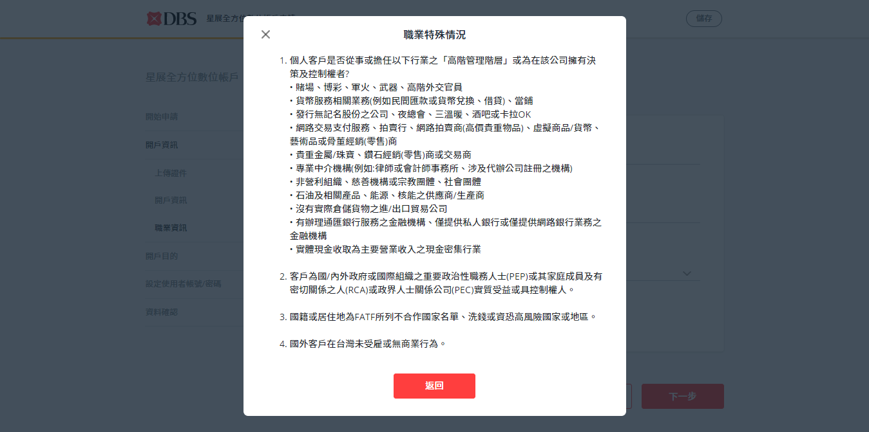
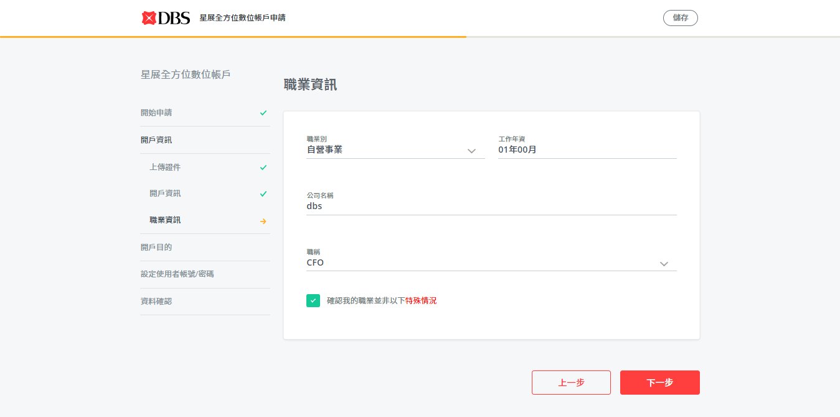
Customer Journey Screen Flow (Web)
基本資料
驗證身分
上傳證件
開戶資訊
職業資訊
開戶目的
資金來源
賬號密碼
資料確認
完成申請
High Risk Occupation Popup
網銀登陸
Note: Customer cannot go through if he doesn’t check the check box
*Other Personal Info Page*

Slide 17
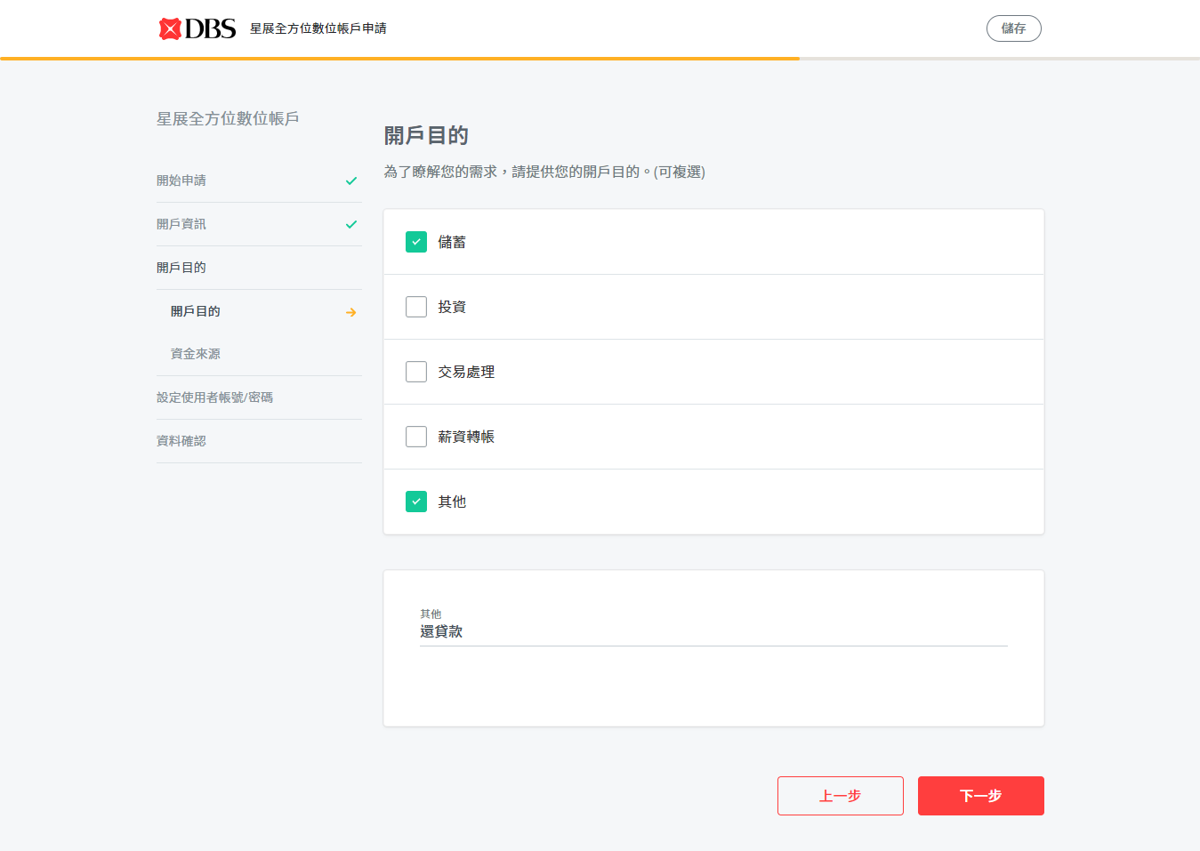
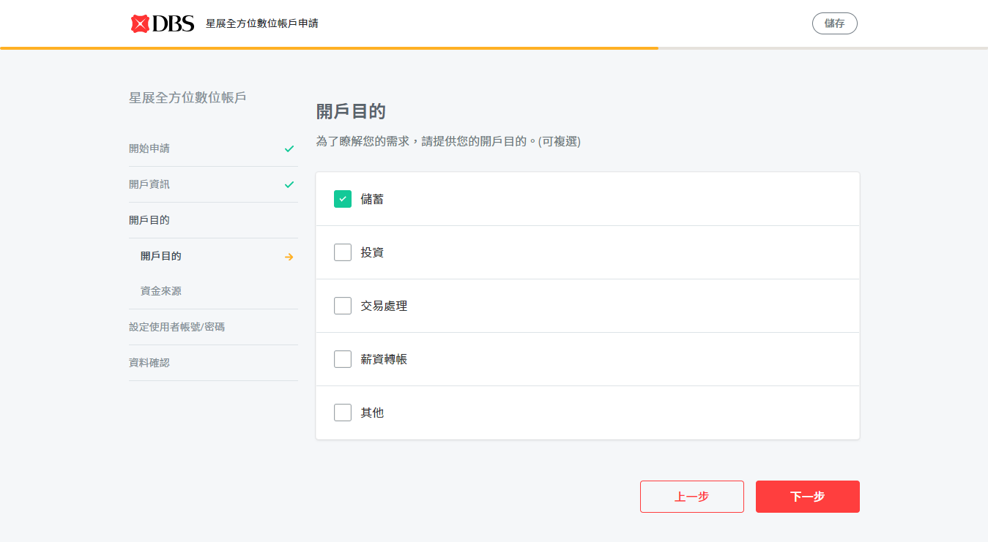
Customer Journey Screen Flow (Web)
基本資料
驗證身分
上傳證件
開戶資訊
職業資訊
Select Others can input items by customers themselves
開戶目的
資金來源
Fields
Check box （可多選）
儲蓄
投資
交易處理
薪資轉賬
其他
如，繳貸款
賬號密碼
資料確認
完成申請
網銀登陸
*Purpose of Account Opening Page*

Slide 18
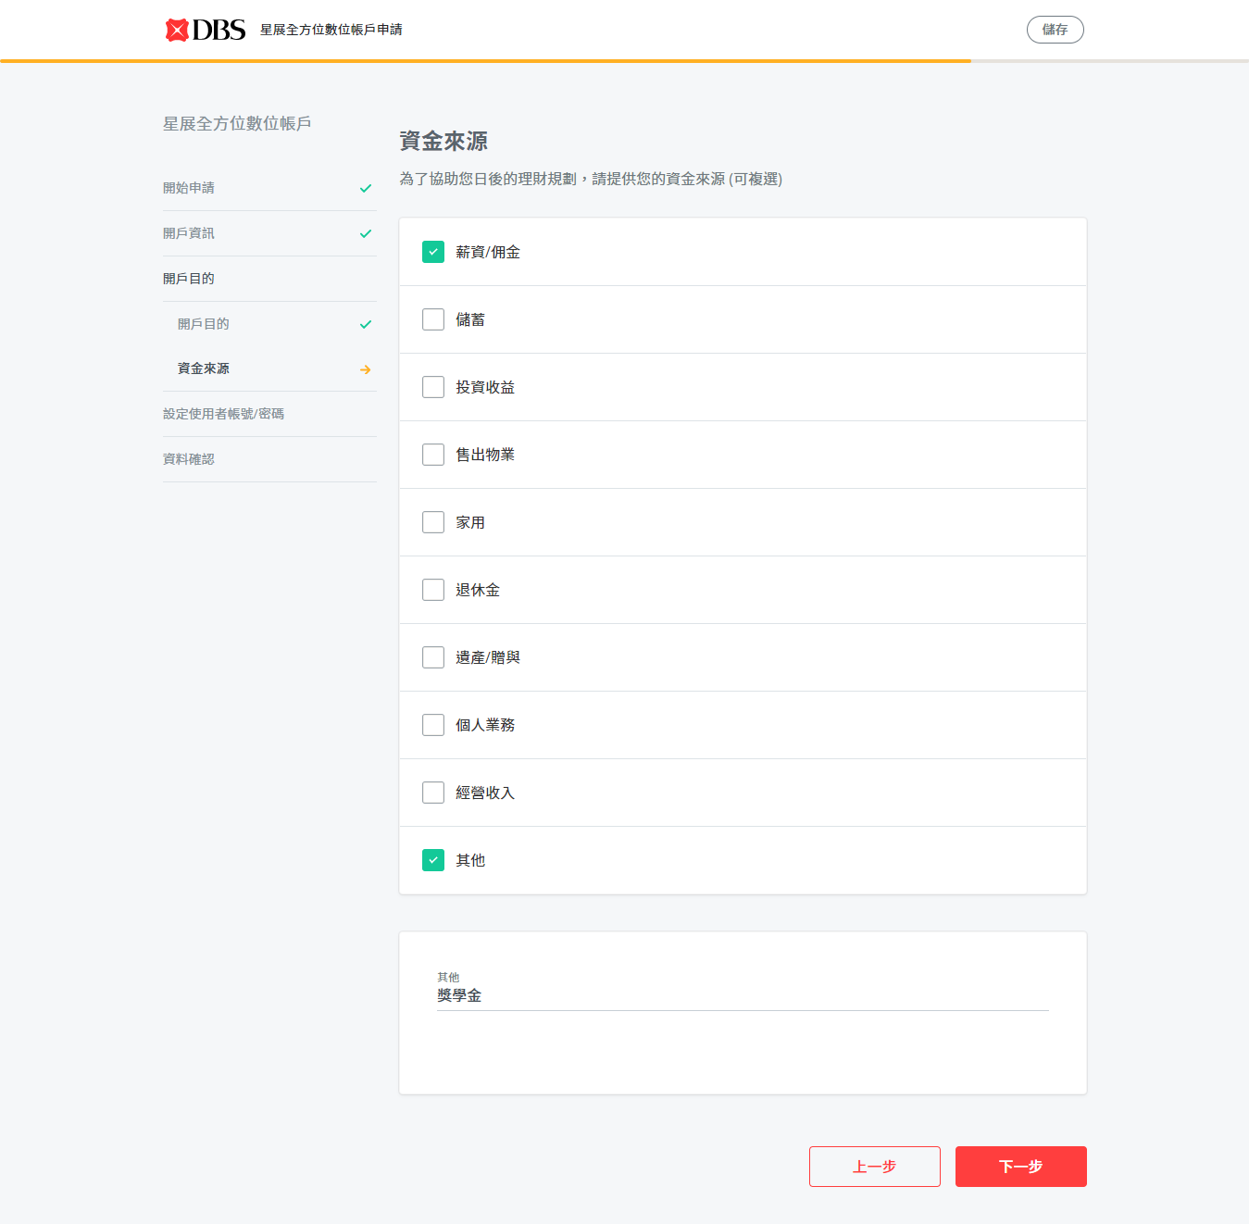
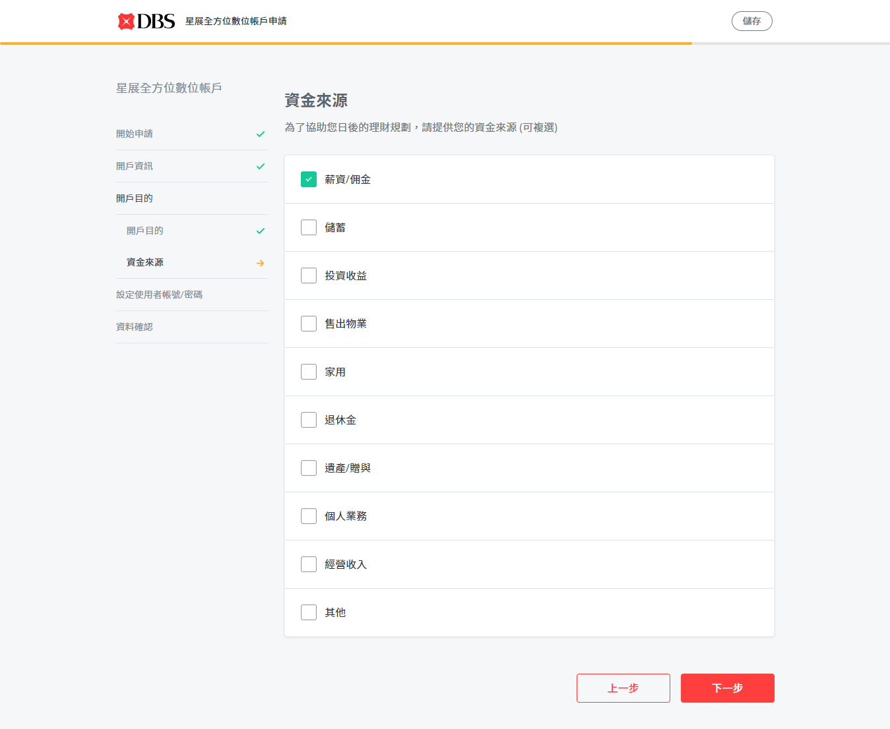
Customer Journey Screen Flow (Web)
基本資料
驗證身分
上傳證件
開戶資訊
Select Others can input items by customers themselves
職業資訊
開戶目的
Fields
Check box
薪資/佣金
儲蓄
投資收益
售出物業
家用
退休金
遺產/贈與
個人業務
經營收入
其他
如，獎學金
資金來源
賬號密碼
資料確認
完成申請
網銀登陸
*Source of Fund Page*

Slide 19
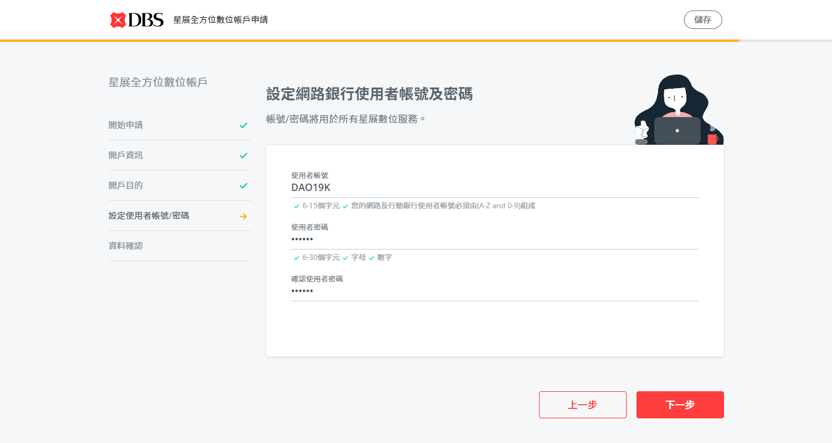

Customer Journey Screen Flow (Web)
基本資料
Fields
User ID
Input
PWD
Input
Confirmed PWD
Input
驗證身分
上傳證件
開戶資訊
職業資訊
開戶目的
資金來源
賬號密碼
資料確認
The tick icon will be green if the UID and pwd match the requirements.
完成申請
網銀登陸
Note: Customer with existing active IB profile will skip this step
*IB Profile Page*

Slide 20
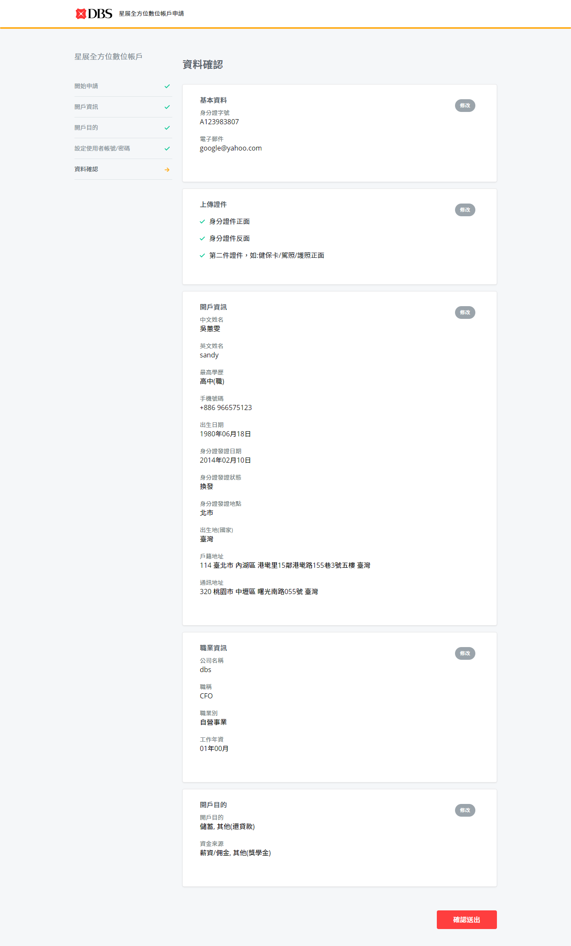
Customer Journey Screen Flow (Web)
基本資料
驗證身分
上傳證件
開戶資訊
職業資訊
開戶目的
Note: Clicking on Edit button will go to the respective page
資金來源
賬號密碼
資料確認
完成申請
網銀登陸
*Preview Page*

Slide 21
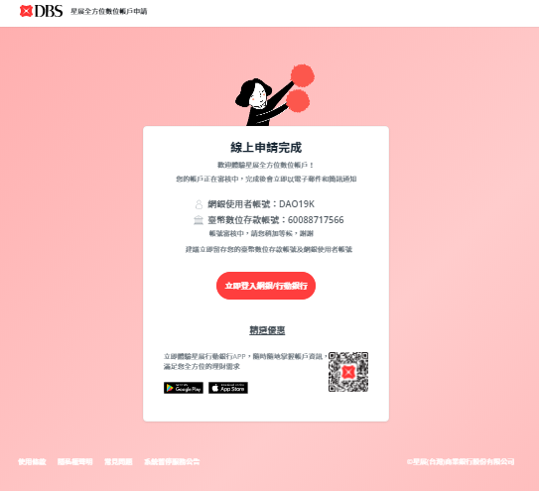

Customer Journey Screen Flow (Web)
基本資料
驗證身分
上傳證件
開戶資訊
職業資訊
開戶目的
Congratulations! We have submitted the application successfully.
資金來源
賬號密碼
資料確認
完成申請
網銀登陸
*Completion Page*

Slide 22
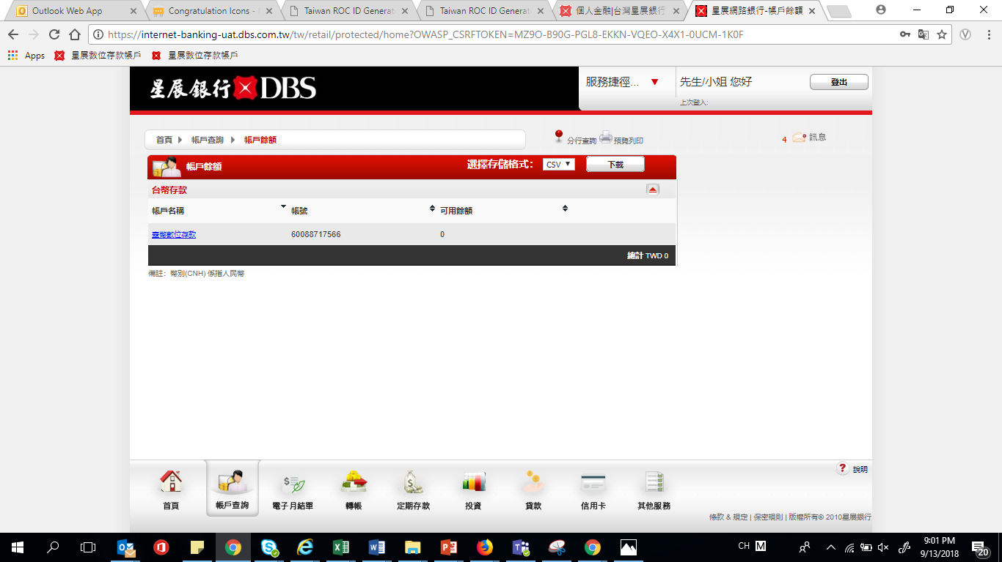
Customer Journey Screen Flow (Web)
基本資料
驗證身分
上傳證件
開戶資訊
職業資訊
開戶目的
Customers can see CASA acc in his IB profile immediately after submission.
資金來源
賬號密碼
資料確認
完成申請
網銀登陸
*Internet Banking Page*

Slide 23


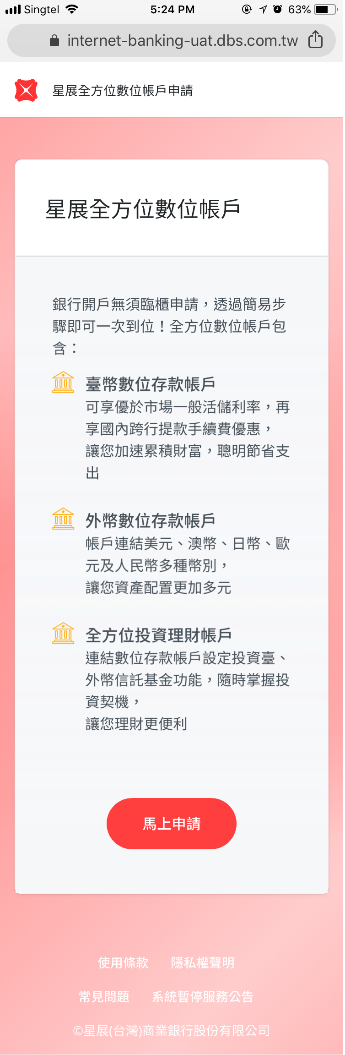
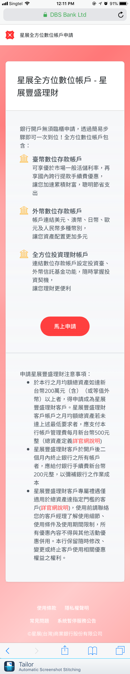
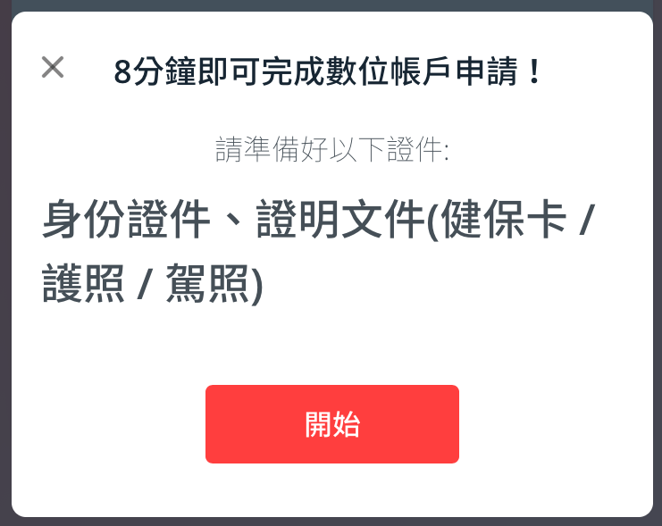

Customer Journey Screen flow(Mobile)
Welcome page:
Mass or treasure customer can select to open LCY, FCY CASA and investment accounts
Mass customer
Treasure customer
Important notice pop up

Slide 24
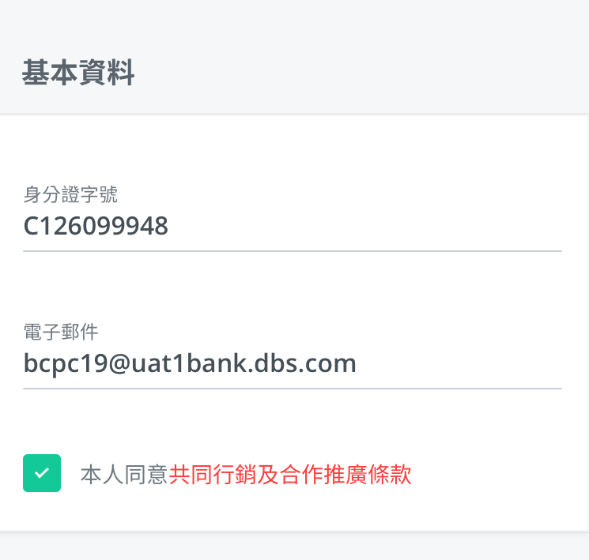
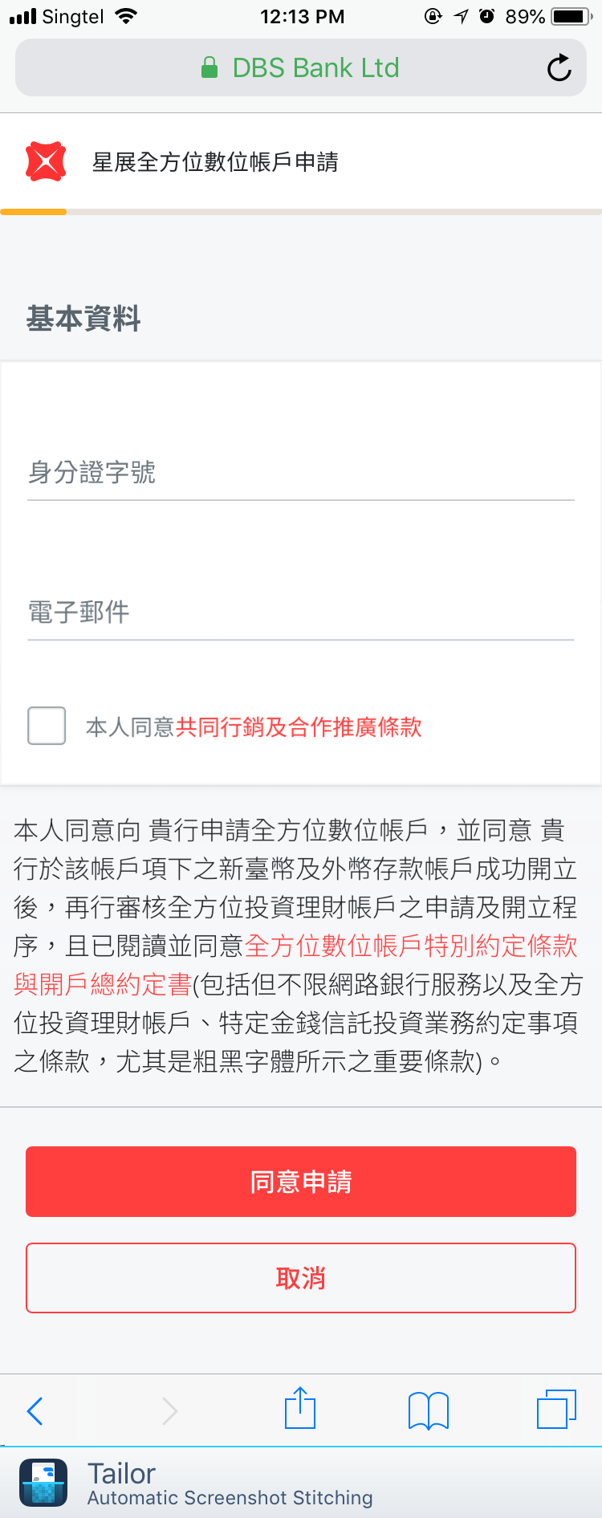
Customer Journey Screen flow(Mobile)
基本資料
驗證身分
上傳證件
開戶資訊
職業資訊
開戶目的
資金來源
賬號密碼
資料確認
Customer input NID and email address
完成申請
網銀登陸
Note: Customer can decide to receive marketing info or not
*Basic information Page*

Slide 25
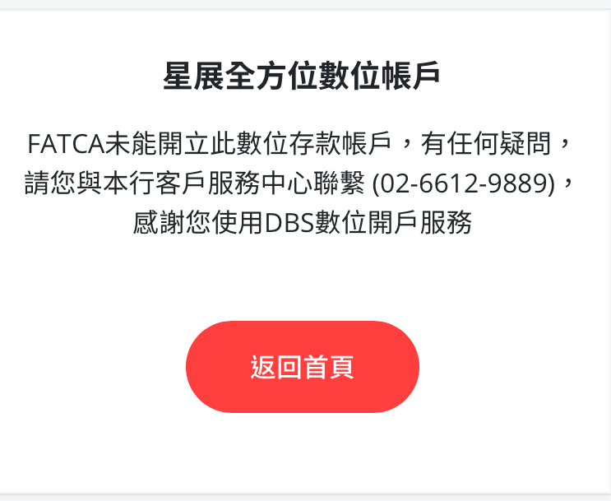
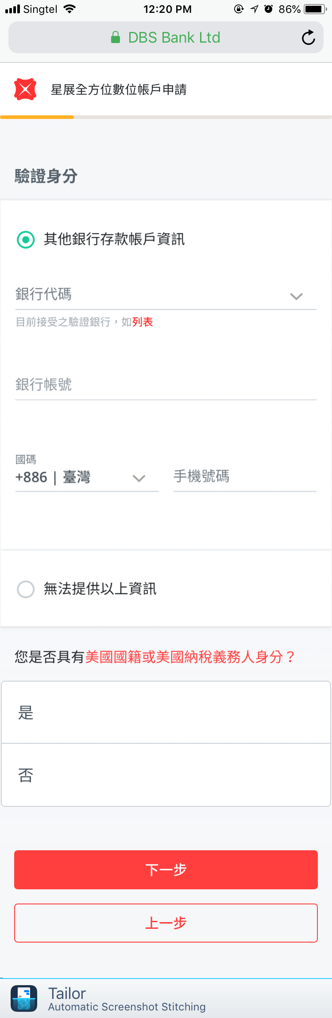
Customer Journey Screen flow(Mobile)
基本資料
驗證身分
上傳證件
開戶資訊
職業資訊
開戶目的
資金來源
賬號密碼
Full screen error msg to indicate FATCA is not able to open this account from DAO
資料確認
完成申請
網銀登陸
*Other Bank Authentication Page*

Slide 26
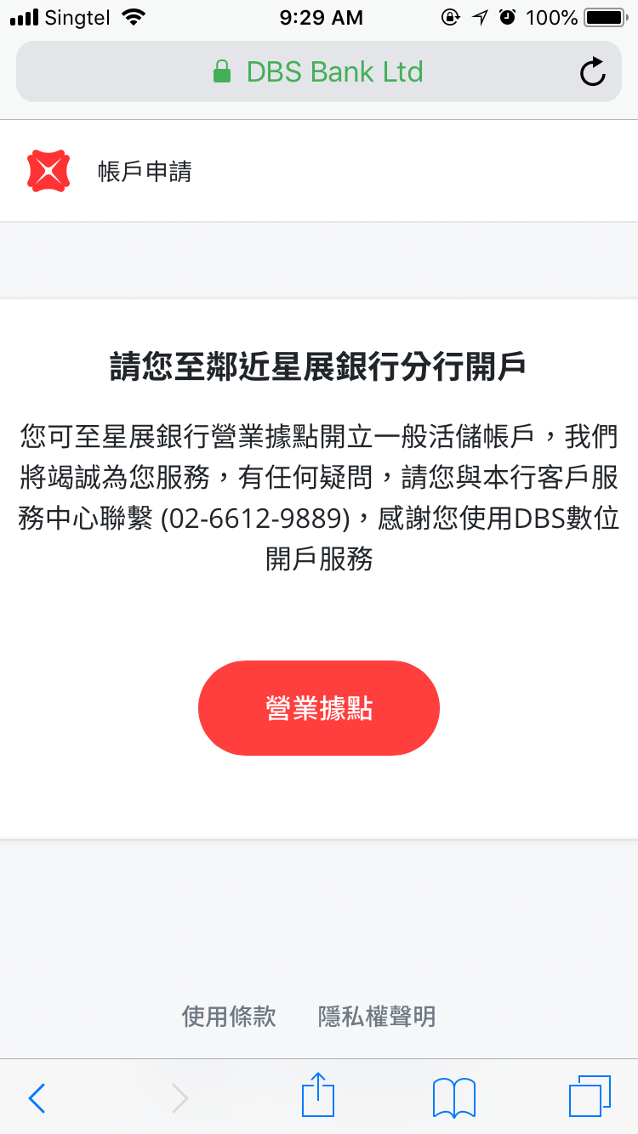
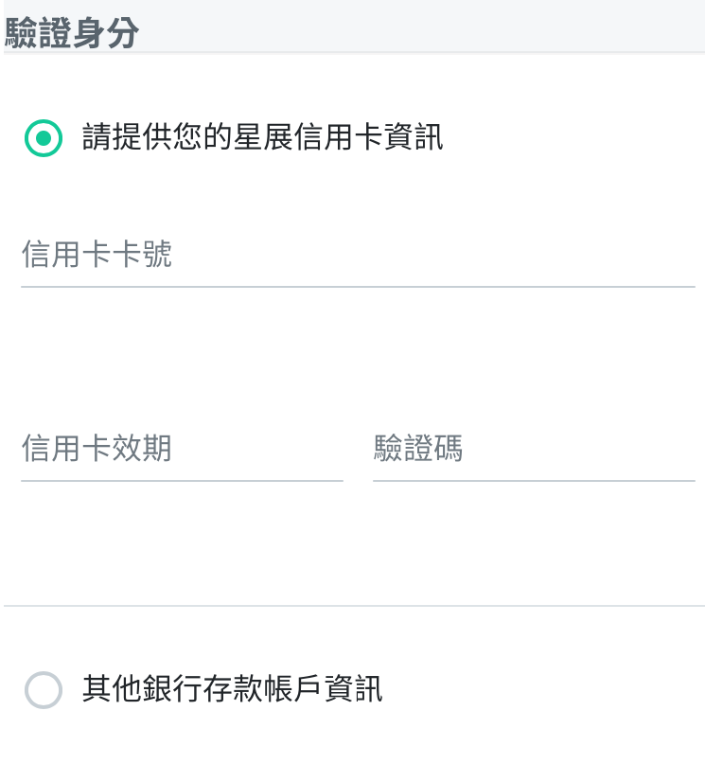
Customer Journey Screen flow(Mobile)
基本資料
驗證身分
上傳證件
開戶資訊
職業資訊
開戶目的
Full Screen msg on clicking on Next button
Customer with DBS credit card has two options
資金來源
Note: The msg is requesting customers to go to branch to open account.
賬號密碼
資料確認
完成申請
網銀登陸
*Other Bank Authentication Page*

Slide 27
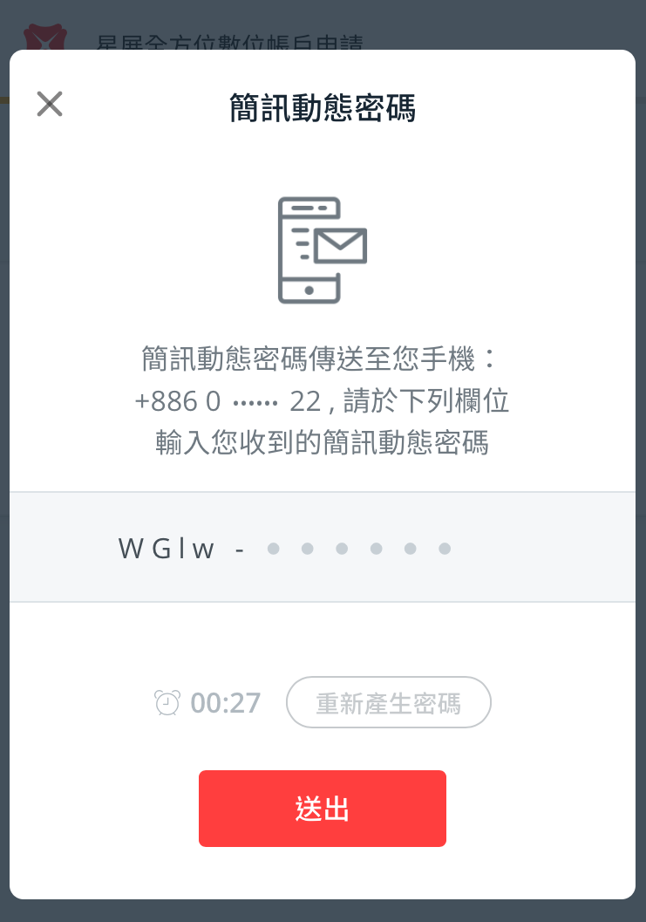
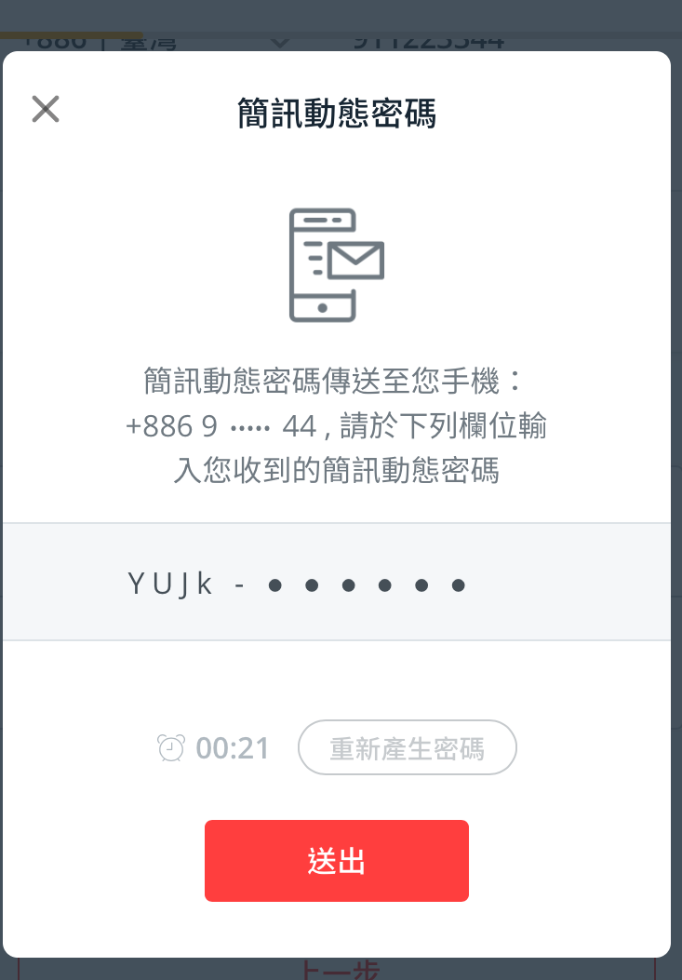
Customer Journey Screen flow(Mobile)
基本資料
驗證身分
上傳證件
開戶資訊
職業資訊
開戶目的
資金來源
賬號密碼
資料確認
完成申請
網銀登陸
*OTP Page (Before)*
*OTP Page (After)*

Slide 28
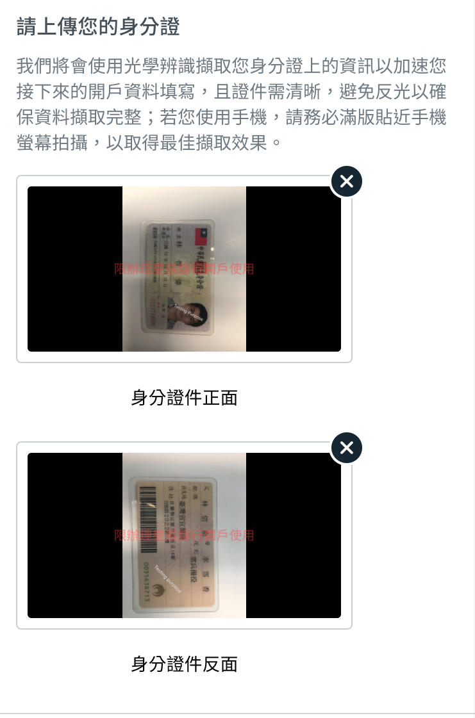
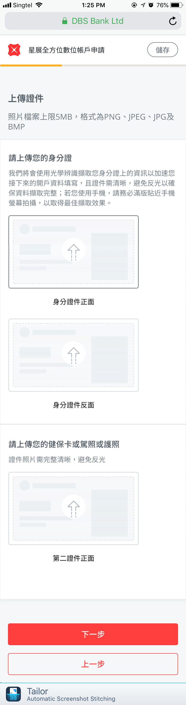
Customer Journey Screen flow(Mobile)
基本資料
驗證身分
上傳證件
開戶資訊
職業資訊
開戶目的
資金來源
賬號密碼
資料確認
完成申請
網銀登陸
Note: Photos display with watermark when upload successfully
*Photo Upload Page*

Slide 29
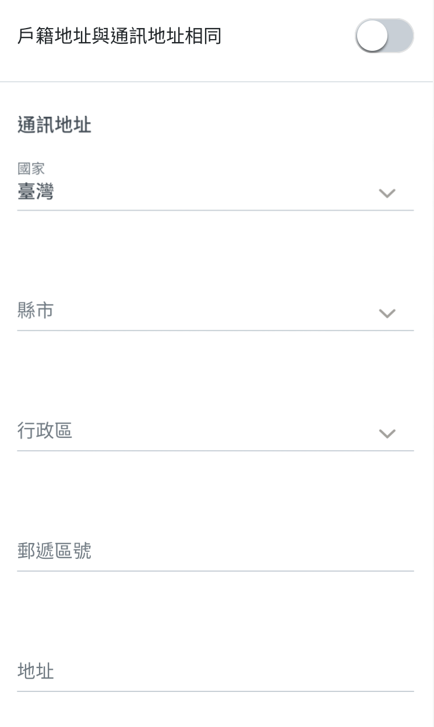
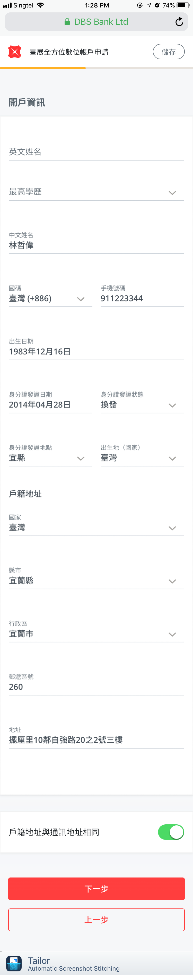
Customer Journey Screen flow(Mobile)
基本資料
驗證身分
上傳證件
開戶資訊
職業資訊
開戶目的
資金來源
賬號密碼
資料確認
完成申請
網銀登陸
Note: Select toggle button off can input mailing address that is different from Residential address
*Personal Info Page*

Slide 30
Customer Journey Screen flow(Mobile)
基本資料
驗證身分
上傳證件
開戶資訊
職業資訊
開戶目的
資金來源
賬號密碼
資料確認
完成申請
網銀登陸
Note: Changing the mobile number in this page will display OTP page again
For NTB and Returnning only
*Personal Info Page*

Slide 31
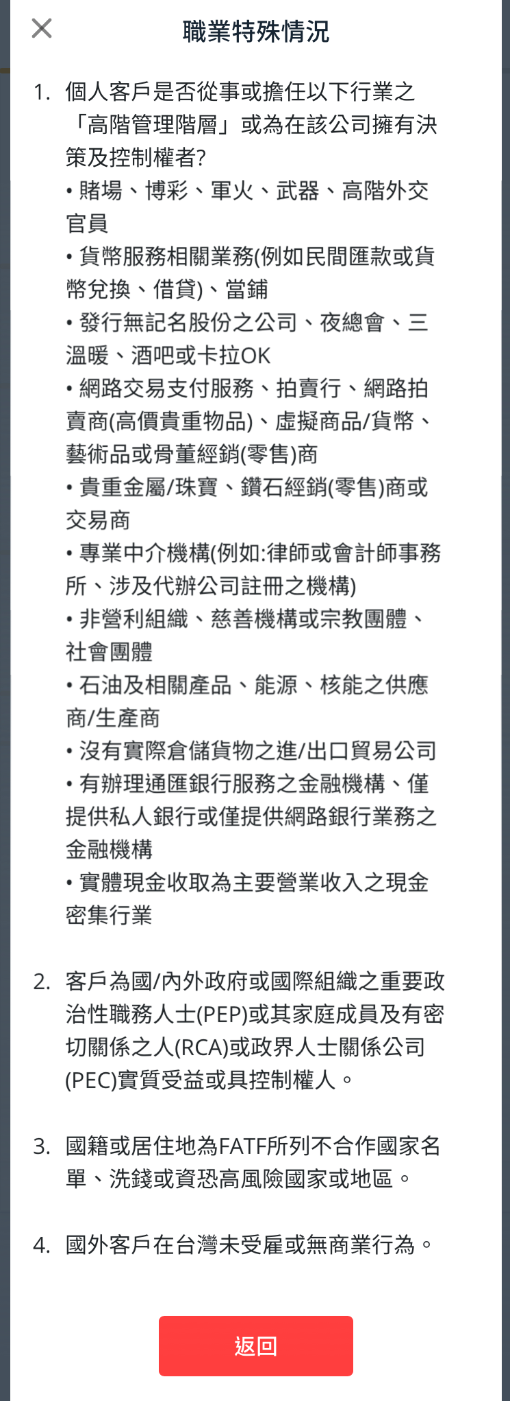
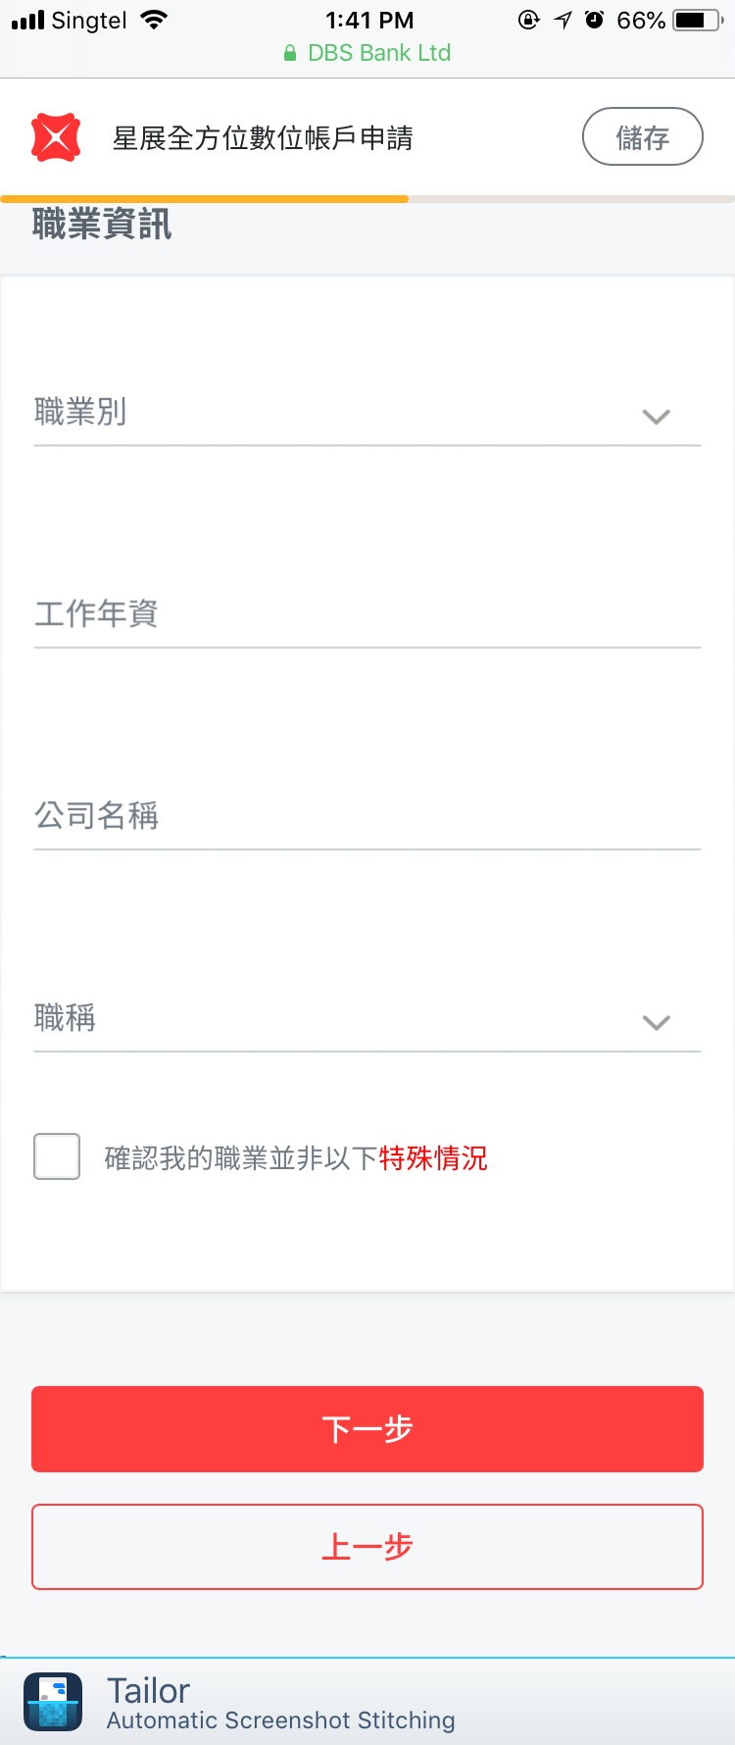
Customer Journey Screen flow(Mobile)
基本資料
驗證身分
上傳證件
開戶資訊
職業資訊
開戶目的
資金來源
賬號密碼
資料確認
完成申請
網銀登陸
Note: Customer cannot go through if he doesn’t check the check box
*Other Personal Info Page*
High Risk Occupation Popup

Slide 32
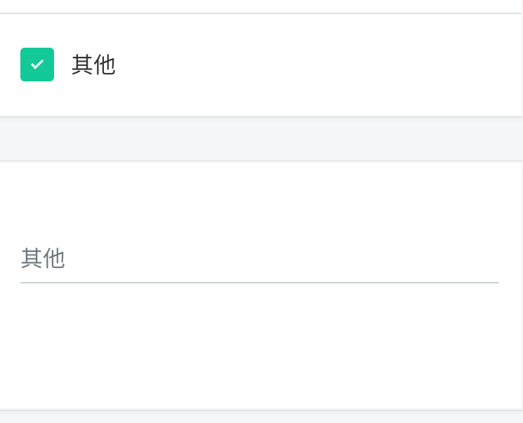
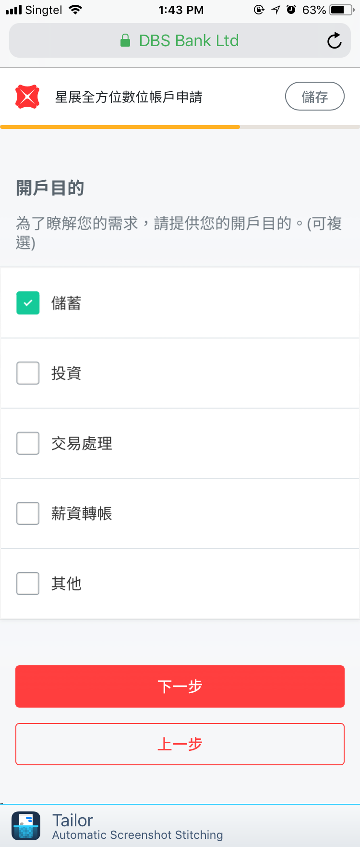
Customer Journey Screen flow(Mobile)
基本資料
驗證身分
上傳證件
開戶資訊
職業資訊
開戶目的
資金來源
Select Others can input items by customers themselves
賬號密碼
資料確認
完成申請
網銀登陸
*Purpose of Account Opening Page*

Slide 33
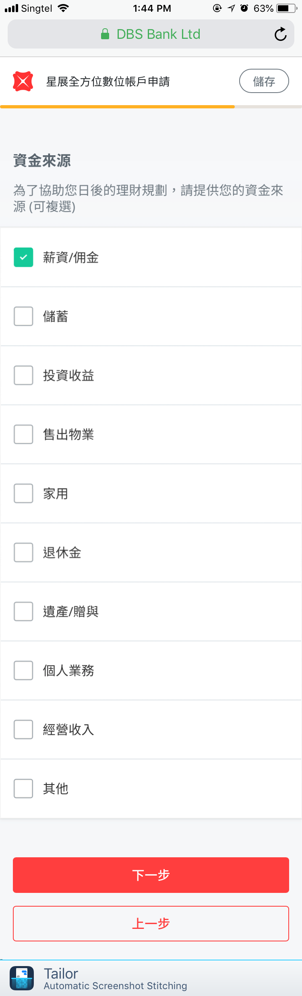
Customer Journey Screen flow(Mobile)
基本資料
驗證身分
上傳證件
開戶資訊
職業資訊
開戶目的
資金來源
Select Others can input items by customers themselves
賬號密碼
資料確認
完成申請
網銀登陸
*Source of Fund Page*

Slide 34
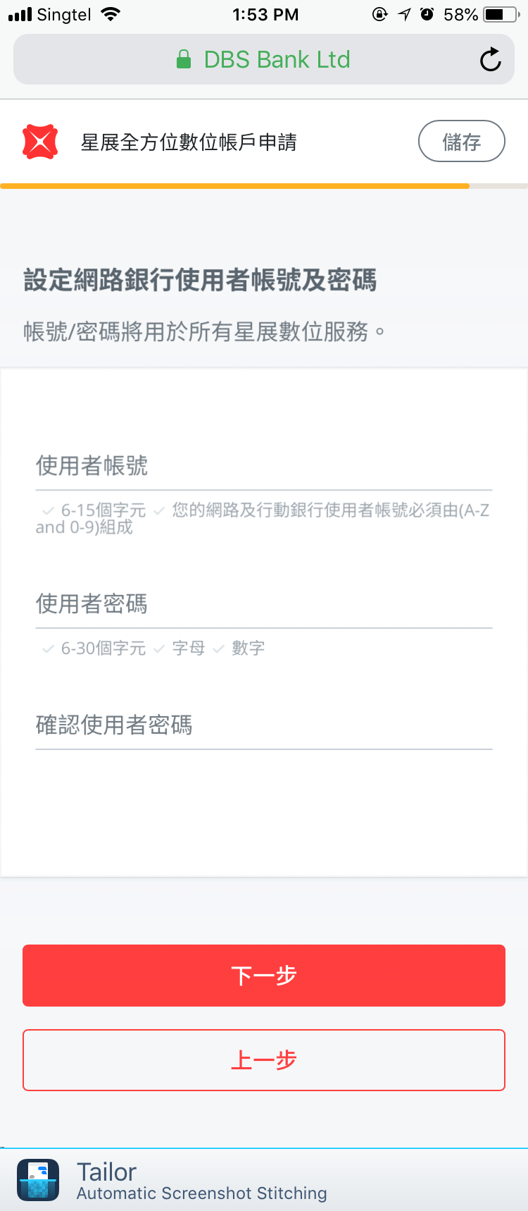
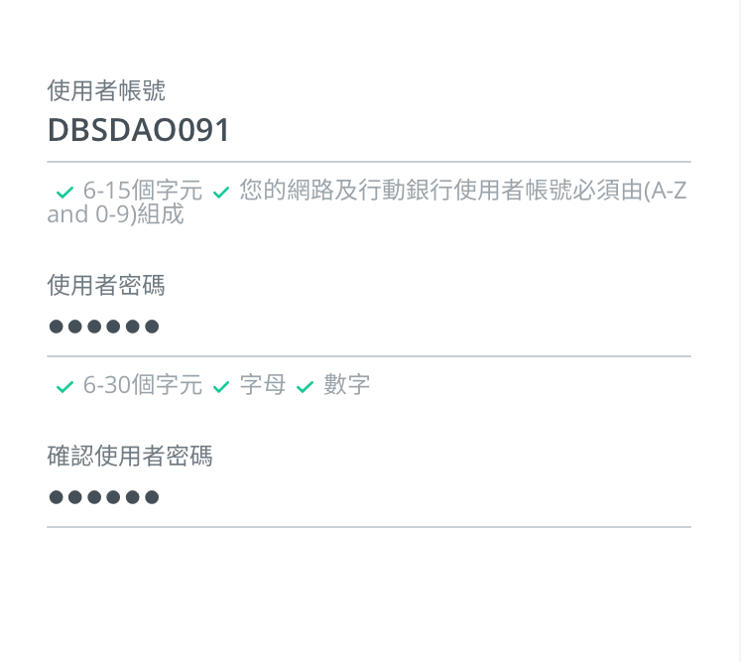
Customer Journey Screen flow(Mobile)
基本資料
驗證身分
上傳證件
Note: Customer with existing active IB profile will skip this step
開戶資訊
職業資訊
開戶目的
資金來源
賬號密碼
資料確認
完成申請
網銀登陸
The tick icon will be green if the UID and pwd match the requirements
*IB/MB Profile Creation Page*

Slide 35
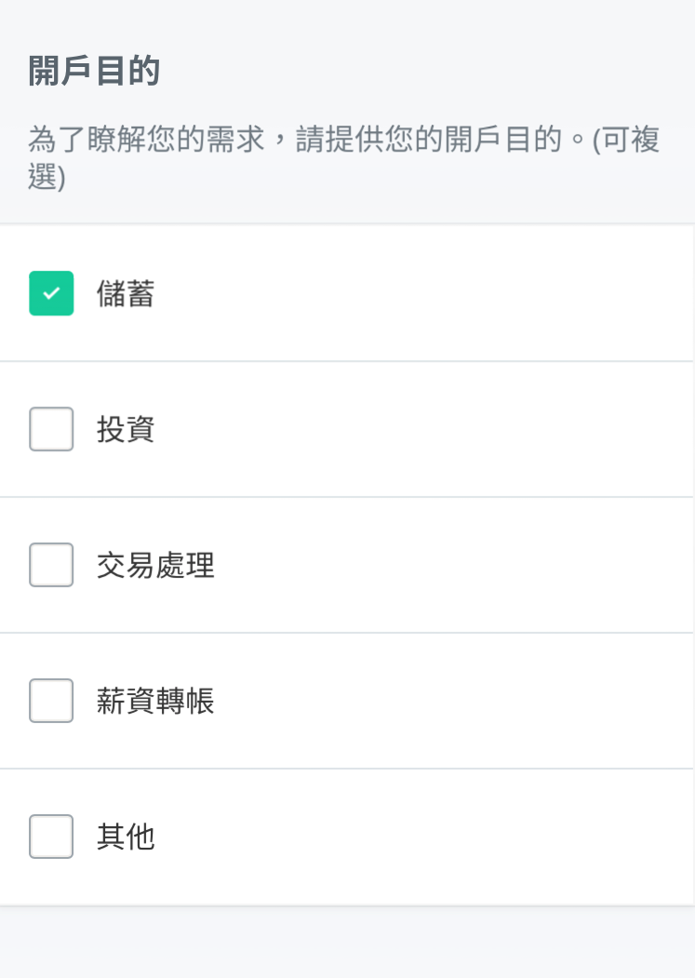
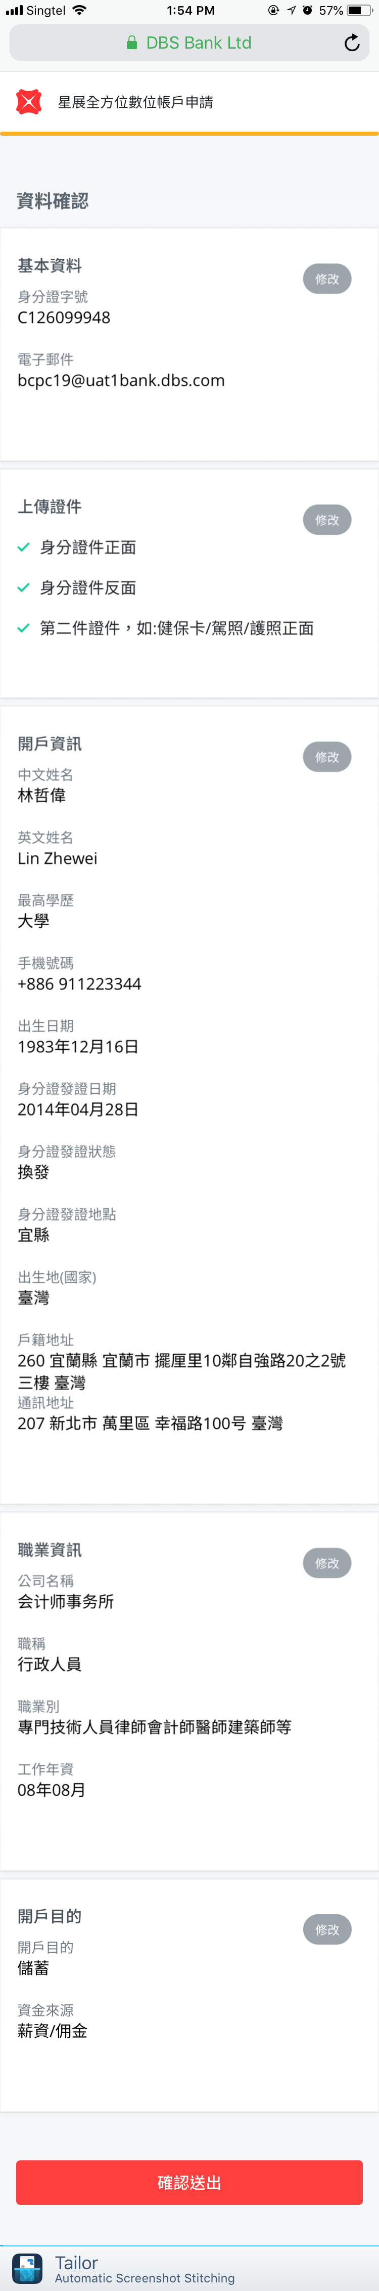
Customer Journey Screen flow(Mobile)
基本資料
驗證身分
上傳證件
開戶資訊
職業資訊
開戶目的
資金來源
賬號密碼
資料確認
完成申請
網銀登陸
Note: Clicking on Edit button will go to the respective page
*Preview Page*

Slide 36
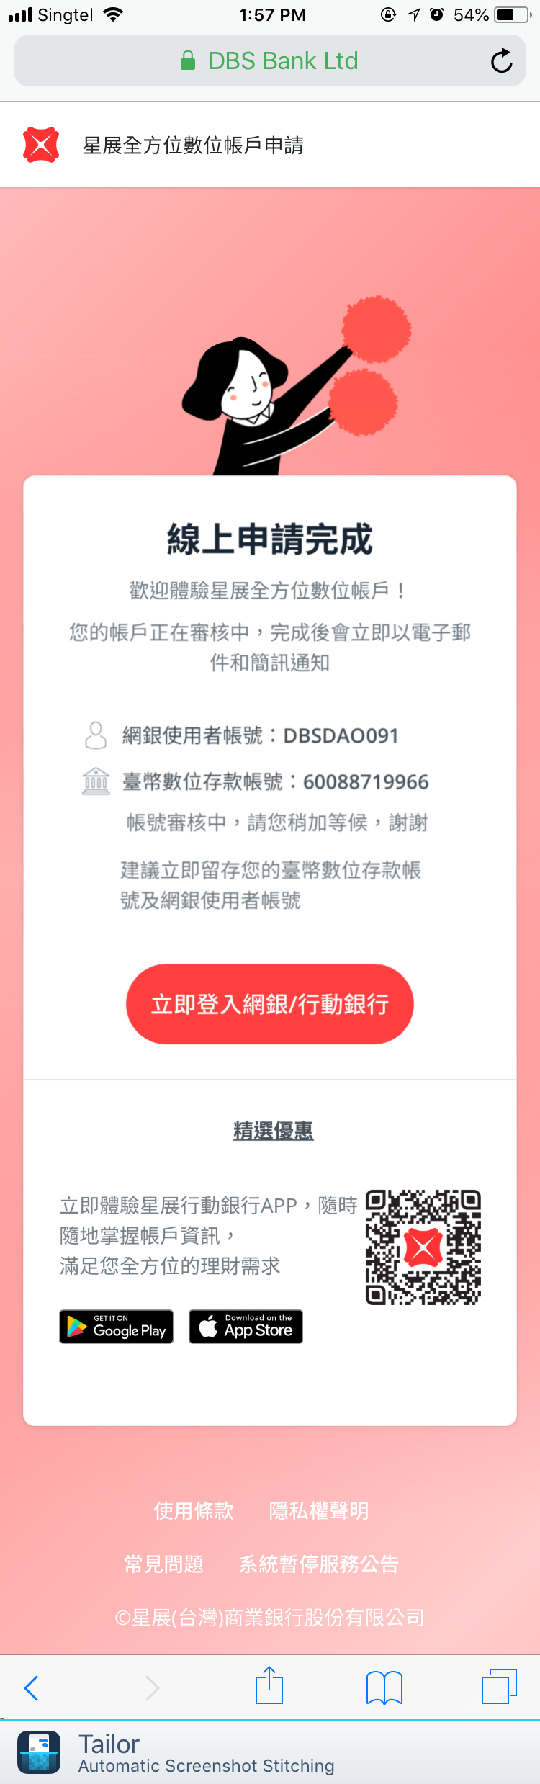

Customer Journey Screen flow(Mobile)
基本資料
驗證身分
Congratulations! We have submitted the application successfully.
上傳證件
開戶資訊
職業資訊
開戶目的
資金來源
賬號密碼
資料確認
完成申請
網銀登陸
Can download the Mobile banking app from App Store
*Completion Page*

Slide 37


Customer Journey Screen flow(Mobile)
基本資料
驗證身分
上傳證件
開戶資訊
職業資訊
開戶目的
資金來源
賬號密碼
資料確認
完成申請
網銀登陸
Customers can see CASA acc in his IB profile immediately after submission.
*Mobile Banking Page*

Slide 38
Other Key Functionalities
Upload document
Format allowed :
Pgn
bmp
jpg
Jpeg
Size allowed : less than 5 mb
For better recognition result:
The photo needs to take up full screen, or as much as possible
Under good lighting condition
Non reflective
OCR
triggered automatically to read NID front and back
OCR Rescan logic(Go back to upload a new photo):
information can be retrieved from OCR
Chinese Name
Birth Date
Issue Date
Issue Status
Issue Place
Residential Address
Case status | customer current step | Trigger OCR?
Incomplete | PI page | Y
Incomplete | Other PI page | N
Request | PI page | N
Request | Other PI page | N

Slide 39
Other Key Functionalities
Field Pre-population and Edition Logic:
Pre-population Priority: Finacle>Vision plus > OCR
Chinese name/mobile number/Mailing address is not editable if prepopulated
Error Message:

Slide 40




Other Key Functionalities
Save:
start from photo upload page to IB profile creation page
Can decide to exit or Continue
Resume:
Have two methods to Resume:
Click url in incomplete/request notifications
Back from Welcome page
Customer can select to start new or continue previous application

Slide 41


Other Key Functionalities
Timeout
Idle timeout:
The timeout value is 10 minutes
Warning message after 5 minutes
Enable this from Welcome page until the Completion screen
Absolute timeout:
The value is 30 minutes
Warning message after 25 minutes
Force logout after 30 minutes with one option to
close

Slide 42


Other Key Functionalities
SMS/ Email Notification
Scenario | Date to send | Times | SMS Sample | Email Sample
application submssion | Immediately | 1
application approval | Immediately | 1
application requested | Immediately | 1
application rejected | Immediately | 1
application saved | 14 PM Next Day Every 2 Days | 3

Slide 43


Other Key Functionalities
Reports
Report Name | Frequency | Format
Audit_Trail_Report | Adhoc | Excel/PDF
Daily_Transaction_Report | Adhoc | Excel/PDF
DAO_Same_IP_mobile_e-mail_Mailing report | Monthly and Weekly | Excel/PDF
Statistics reports | Adhoc | Excel/PDF
NTB application report | Adhoc | Excel/PDF
NTB Monthly Summary Report | Monthly | Excel/PDF
NTB Weekly Summary Report | Weekly | Excel/PDF
Manual UID and PWD creation Report | Adhoc | Excel/PDF

Slide 44


Other Key Functionalities
IWF Screen
*Workflow Page*
*Portal Page*

Slide 45


Other Key Functionalities
IWF Screen
*Case Detail Tab*
*KYC Tab*

Slide 46

Other Key Functionalities
IWF Screen
*Wrapup Tab after customer Submission*
*Wrapup Tab after ops approval*

Slide 47
Other Key Functionalities
IWF Case status
Fr Status Below to | Incomplete | Pending | Approve | Request | Reject/Block | Error | Expired | Completed
Incomplete | By system | By system |  |  | By system |  | By system
Pending |  |  | By Ops | By Ops | By Ops |  | By system
Approve |  |  |  |  |  | By system |  | By system
Request |  | By system |  |  |  |  | By system
Reject/Block |  |  |  |  |  |  | By Ops
Error |  |  |  |  |  |  |  | By Ops
Expired
Completed
Approved
Reject
Block
Pending
Errored
Expired
Request
Incomplete
Complete
Ops approved the case
Ops rejected the case
Block customer due to some issues. Can retry next day.
Customers submit the application
System error in acc/CIF/IB profile creation
Application is pending for action more than 30 days
Ops request customer to upload more clear photos
Customers save the application and exit
Front end and Back end process are both completed

Slide 48


Other Key Functionalities
Offline Process
Branch can upgrade Type III to Type I CASA
Added 4 Scheme Codes for Type III CASA and Type I CASA
Added a memopad on application submission
Added the other memopad on application approval
Scheme Type | A/C Type | Scheme Codes | Description
ODA | TWD CASA | LDASA | TWD Type III digital account
 | TWD CASA | LDUSA | Account Upgrade from TWD Type III digital account after walk into branch
 | FCY CASA | FCASA | FCY Type III digital account
 | FCY CASA | FDUSA | Account Upgrade from FCY Type III digital account after walk into branch

Slide 49


Other Key Functionalities
CRM
For TR customer, Age check and FATCA check failed will flow to CRM
Below Info will flow to CRM
• Scenario Type (DAO Treasure FATCA check)
• NID
• Email
• Mobile Number
• Product selection (3 treasure package)
• Residential Address (If user is ETB, need get the information)
• Reason Code
• Description
• Apply Date
• Campaign code (will be in URL)

Slide 50
FAQ
Question 1:
When will my application be processed?
Application before 4PM will be processed on the current day. Applications after 4PM will be processed Next day.
Question 2:
Where can I check my application status?
Once your case is processed, email and SMS notification will be sent to you immediately.
Question 3:
Why is my application rejected?
Possibility because your ejcic info is not available for application..
Question 4:
Why is garbage msg appearing in PI page?
..
Question 5:
Why is my handphone no is not editable?
Your handphone no. , mailing address and Chinese name belongs to confidential information. To guarantee your information safety, these fields are set to “not editable”

